Slide 1
Grassroots School Based Food Assistance
Interstate 35 School
http://www.roadrunnerpride.org/
Notes:
Sue

Slide 2
Mission
It is our mission to proactively alleviate childhood hunger in our school through a grassroots community based approach in an effort to insure student academic success.
Notes:
Sue

Slide 3
What is our story
How can a rural school district of 198 square miles with approximately 850 students meet the hunger need of our community?
How can we conquer the food desert we live in amongst fields of corn and soybeans?
Grassroots with no hoops to jump through and an end goal of zero hunger.
How did a school of 800+ kids in a rural area become a community of hunger fighters?
Iowa Hunger Summit - Sue
Rural Hunger - Heidi
Public School & Hunger - Jacob

Slide 4
Program Components
Weekly Backpack Meal Program Est. 2014
Weekly Backpack Buddies Program Est. 2015
Community Food Pantry Est. 2016
A Brief Overview
Notes:
Jacob

Slide 5
Managing a Grassroots Food Assistance Program Within a Public School:
Identify Need
self determined need by elementary families
free and reduced data
teacher and nurse referrals
open invitation to entire community for students and seniors, contact database.
Keep it Simple
Notes:
Jacob

Slide 6
Delivery of Service
Feeding the Hungry
Community pantry open for individuals as needed
Friday bags delivered for student distribution of weekend individual supplemental food
Weekly backpack family supplemental food
School-Based Kitchen Garden to supplement school lunch program.
How do we do it?
Notes:
Sue 1 st & 4th
Jacob 2nd and 3rd

Slide 7
Stocking Our Stores
Food pantry and backpack buddy program is stocked via the Food Bank of Iowa
Backpack program stocked via community, student, church based donations
Kitchen garden is developed and managed by middle school and elementary science classes and expanding soon with indoor greens wall during off season
Food, Food Everywhere
Notes:
Sue

Slide 8
Program Impacts & Successes
Data
43 Student Backpack (up 100% from 2017-18) with over 400 meals supplied weekly impacting 16 families
Food Pantry 26 families
Total students served 66.
Total households served 42
Donations
MS Advisory Food Drives
Local Church Donations
Community Donations
Power Snack
Feedback
No hoops
No restrictions
From Teachers
From Families
From Community
Why It Works!?!
Notes:
Jacob Data, Power Snack, Teacher Feedback
Sue Donations Food Drive & Church (St Charles & New Virginia Methodist) - gift cards - Community

Slide 9
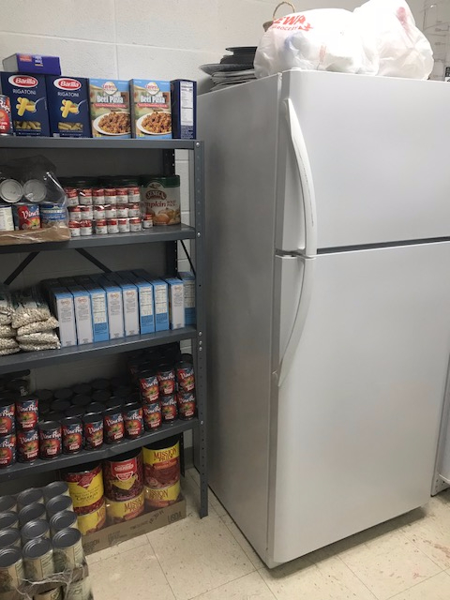
Food Pantry Cold Storage
Food Bank of Iowa allowed funds for freezer and refrigerator purchases.
Notes:
SUe

Slide 10
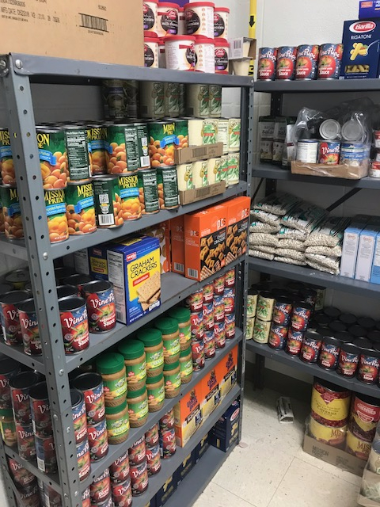
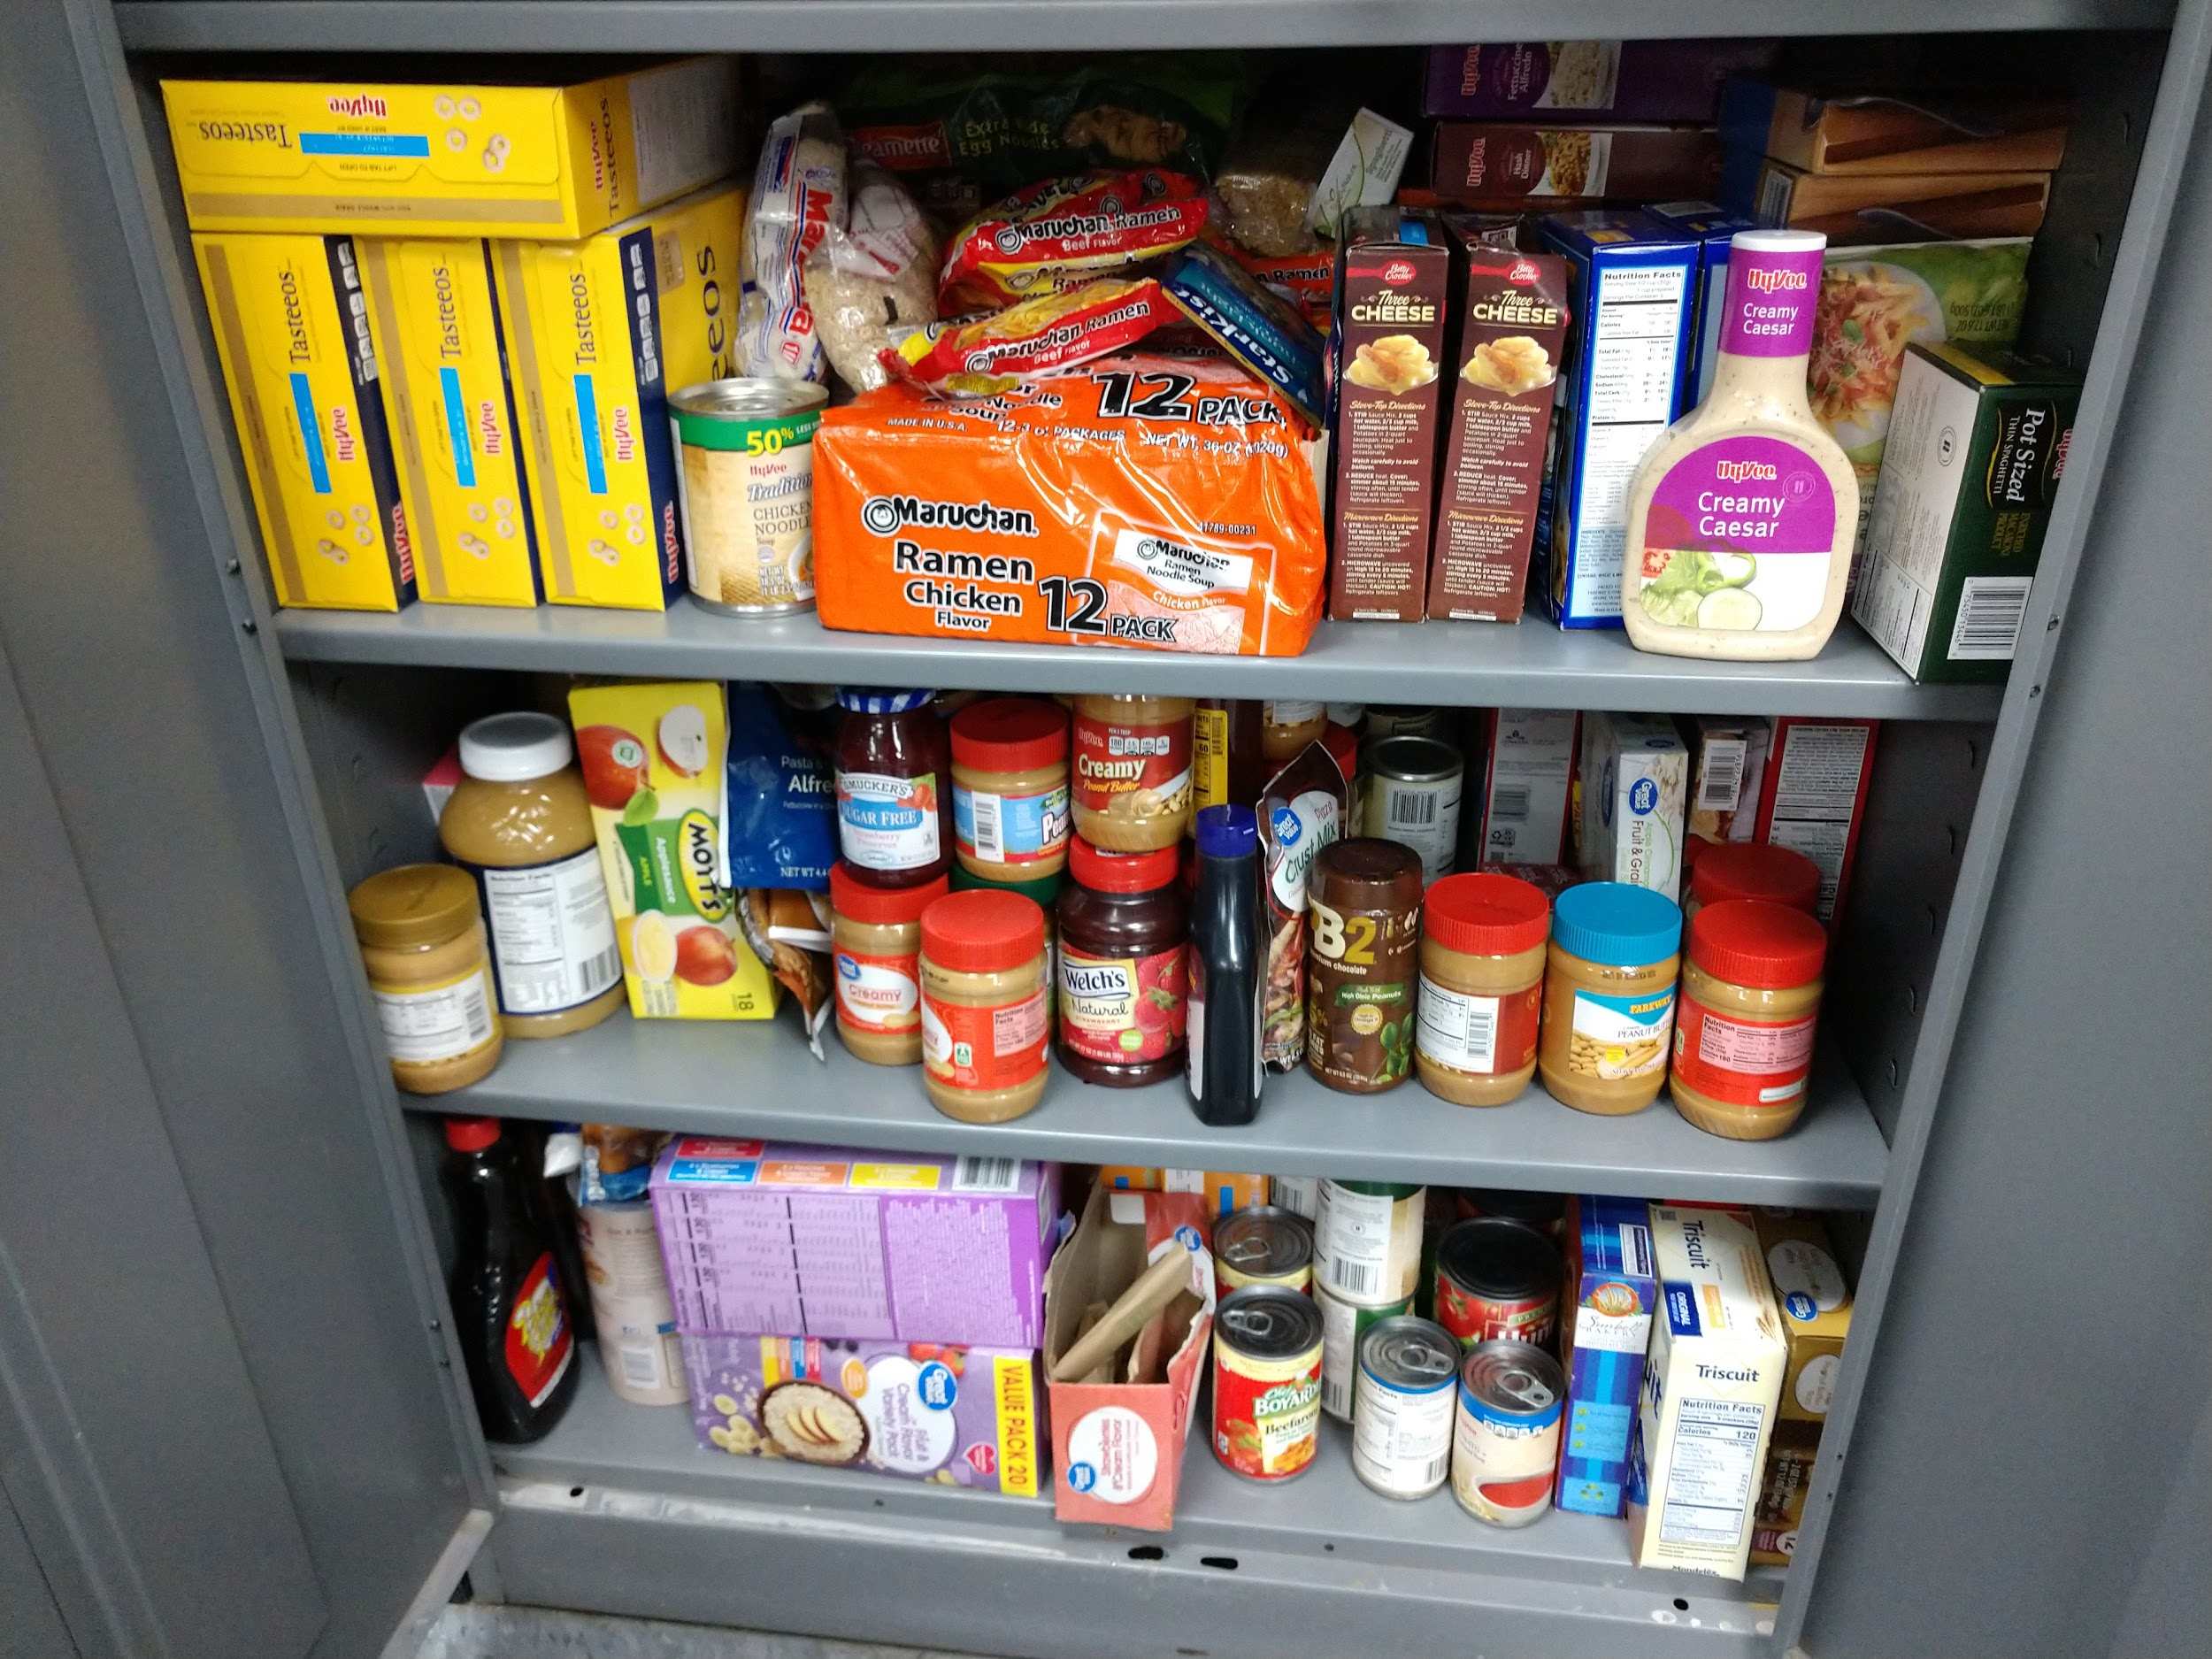
Food Pantry & Backpack
Limited Storage Space
Utilized a corner of the FCS laundry room to set shelves for pantry non-perishables. Storage cabinet in science classroom stores backpack program donations
Notes:
Sue

Slide 11
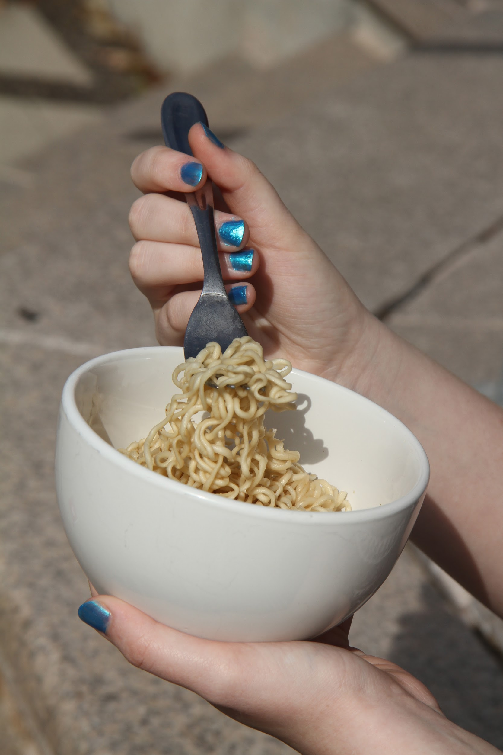
Food Pantry Assists with Daily
Student Hunger
High school students are never turned down
Food is available as an “on-site meal” to students during school day. Elementary and middle school students utilize snacks our in house supplies
Notes:
Jacob - Student snacks from bag, extra food bags

Slide 12
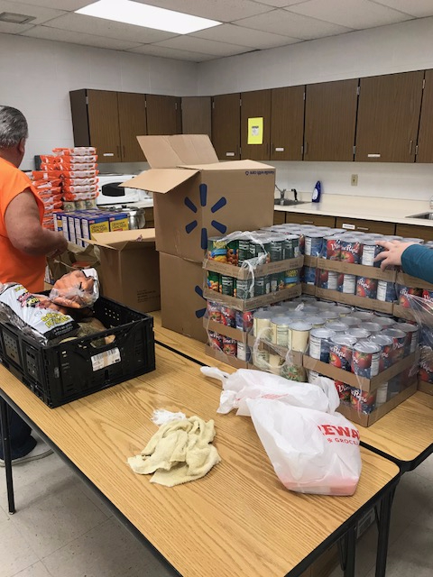
Open Pantry Days
The Food Bank of Iowa offers monthly delivery to our school.
A community volunteer picks up food between deliveries.
Notes:
SUe

Slide 13
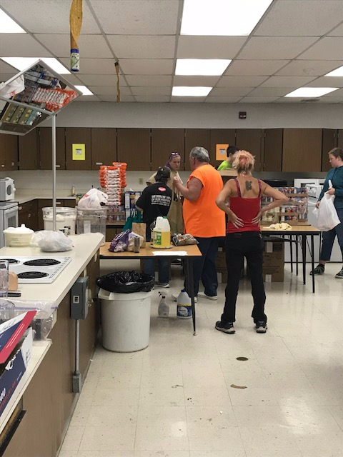
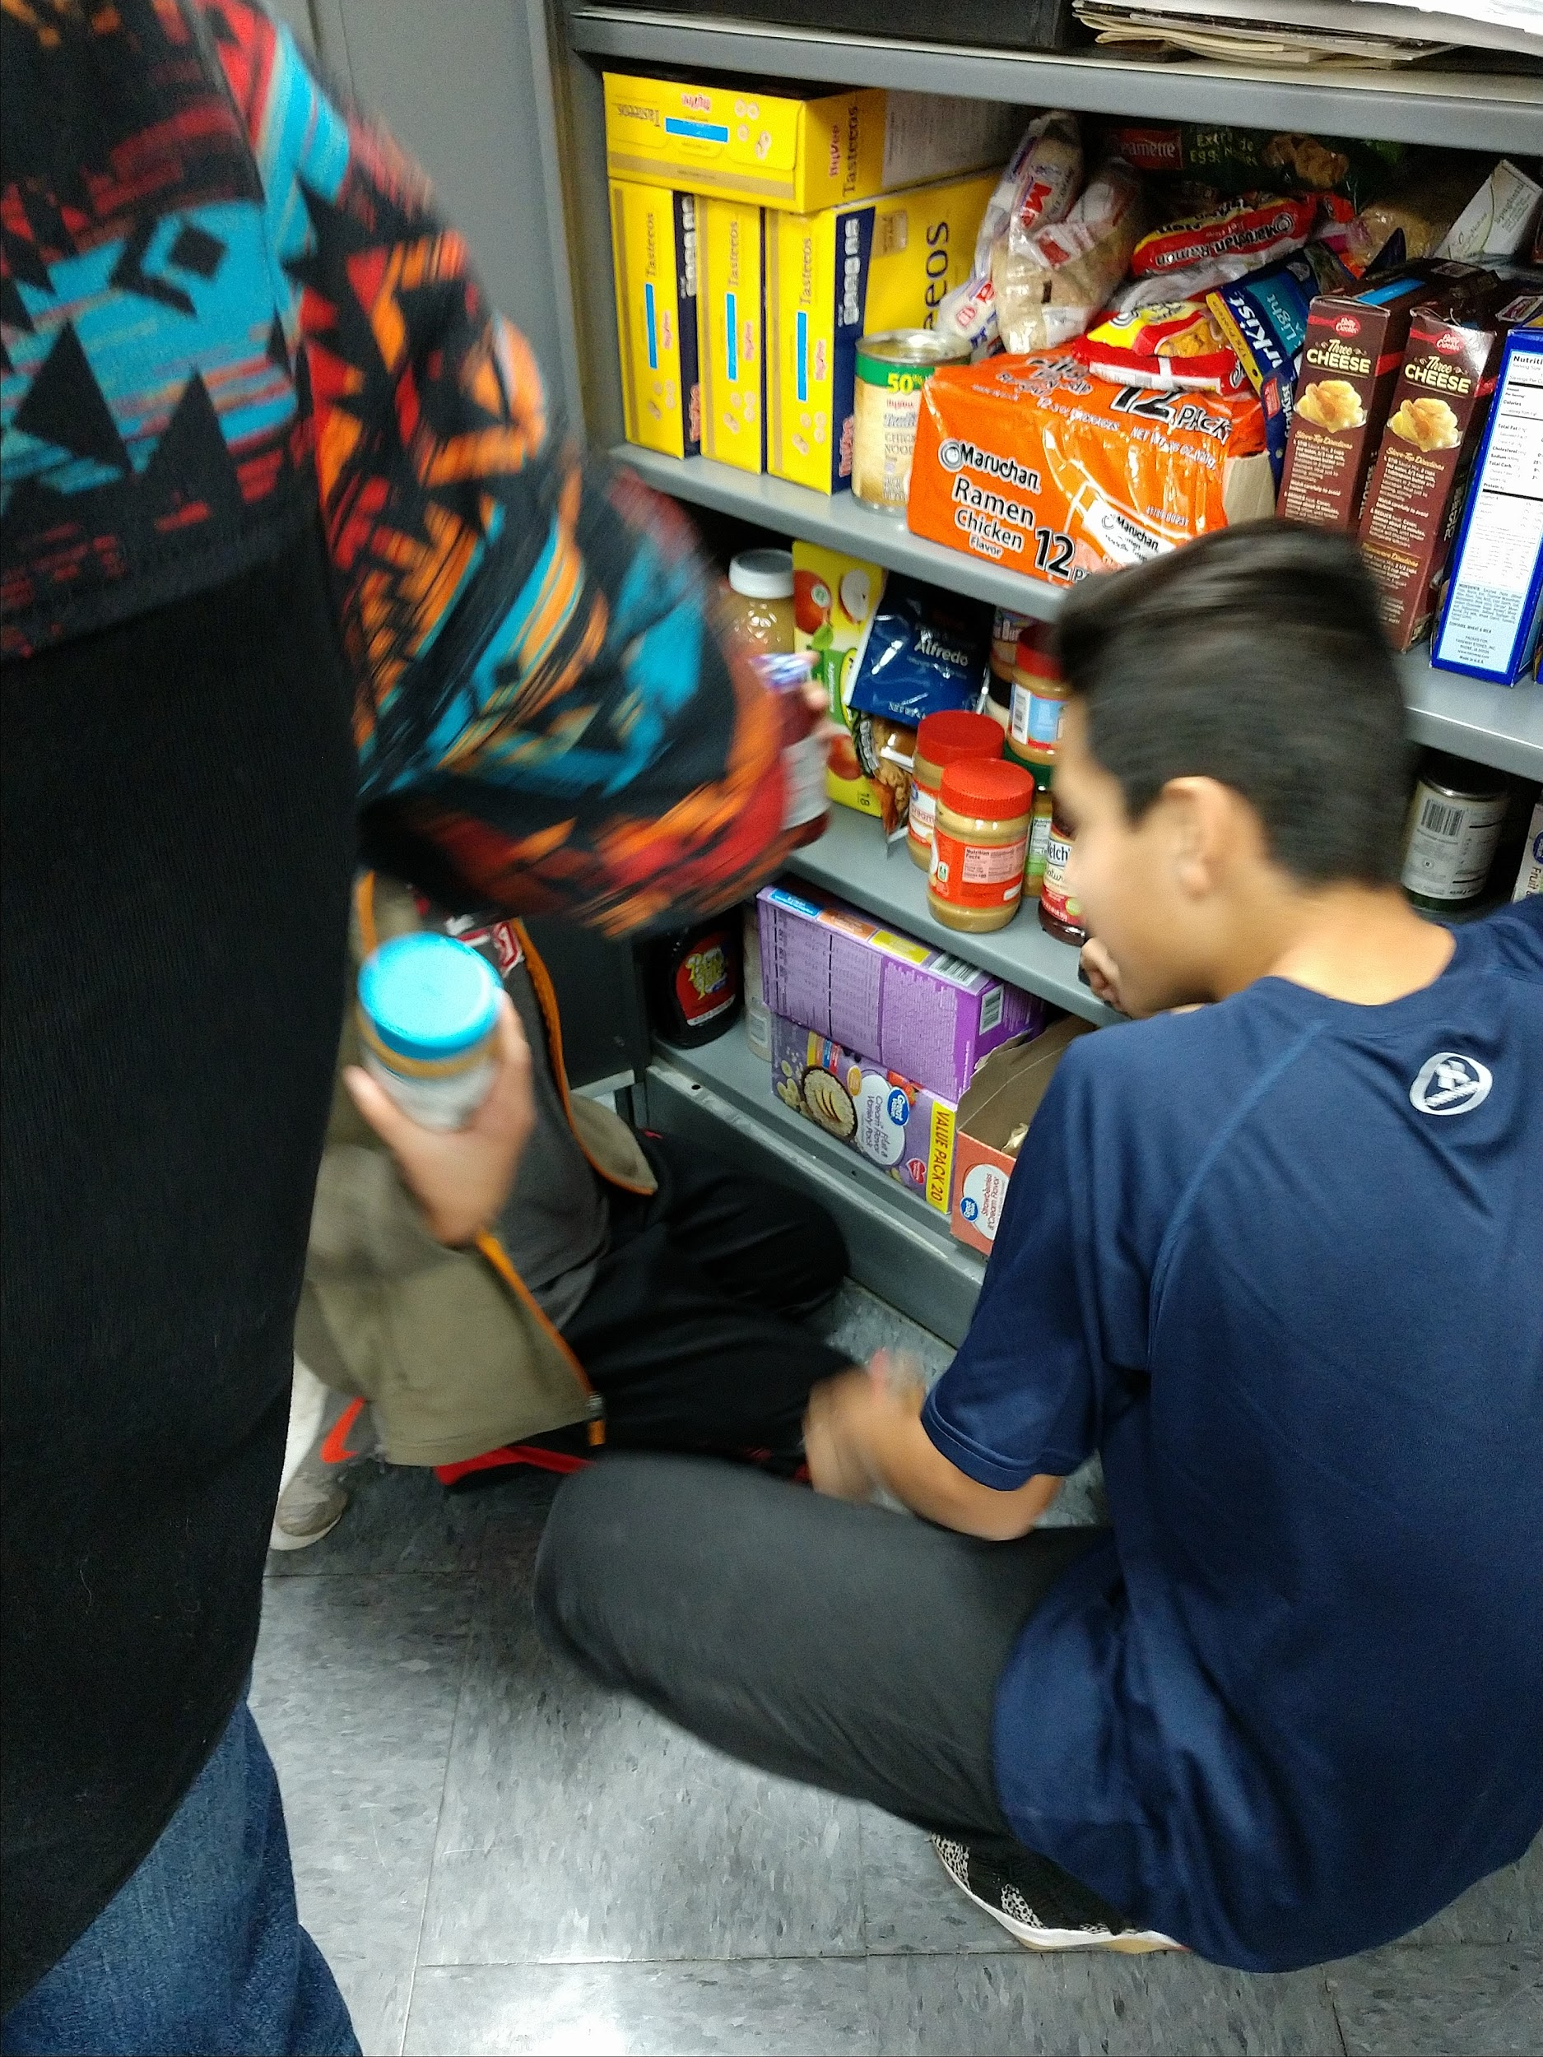
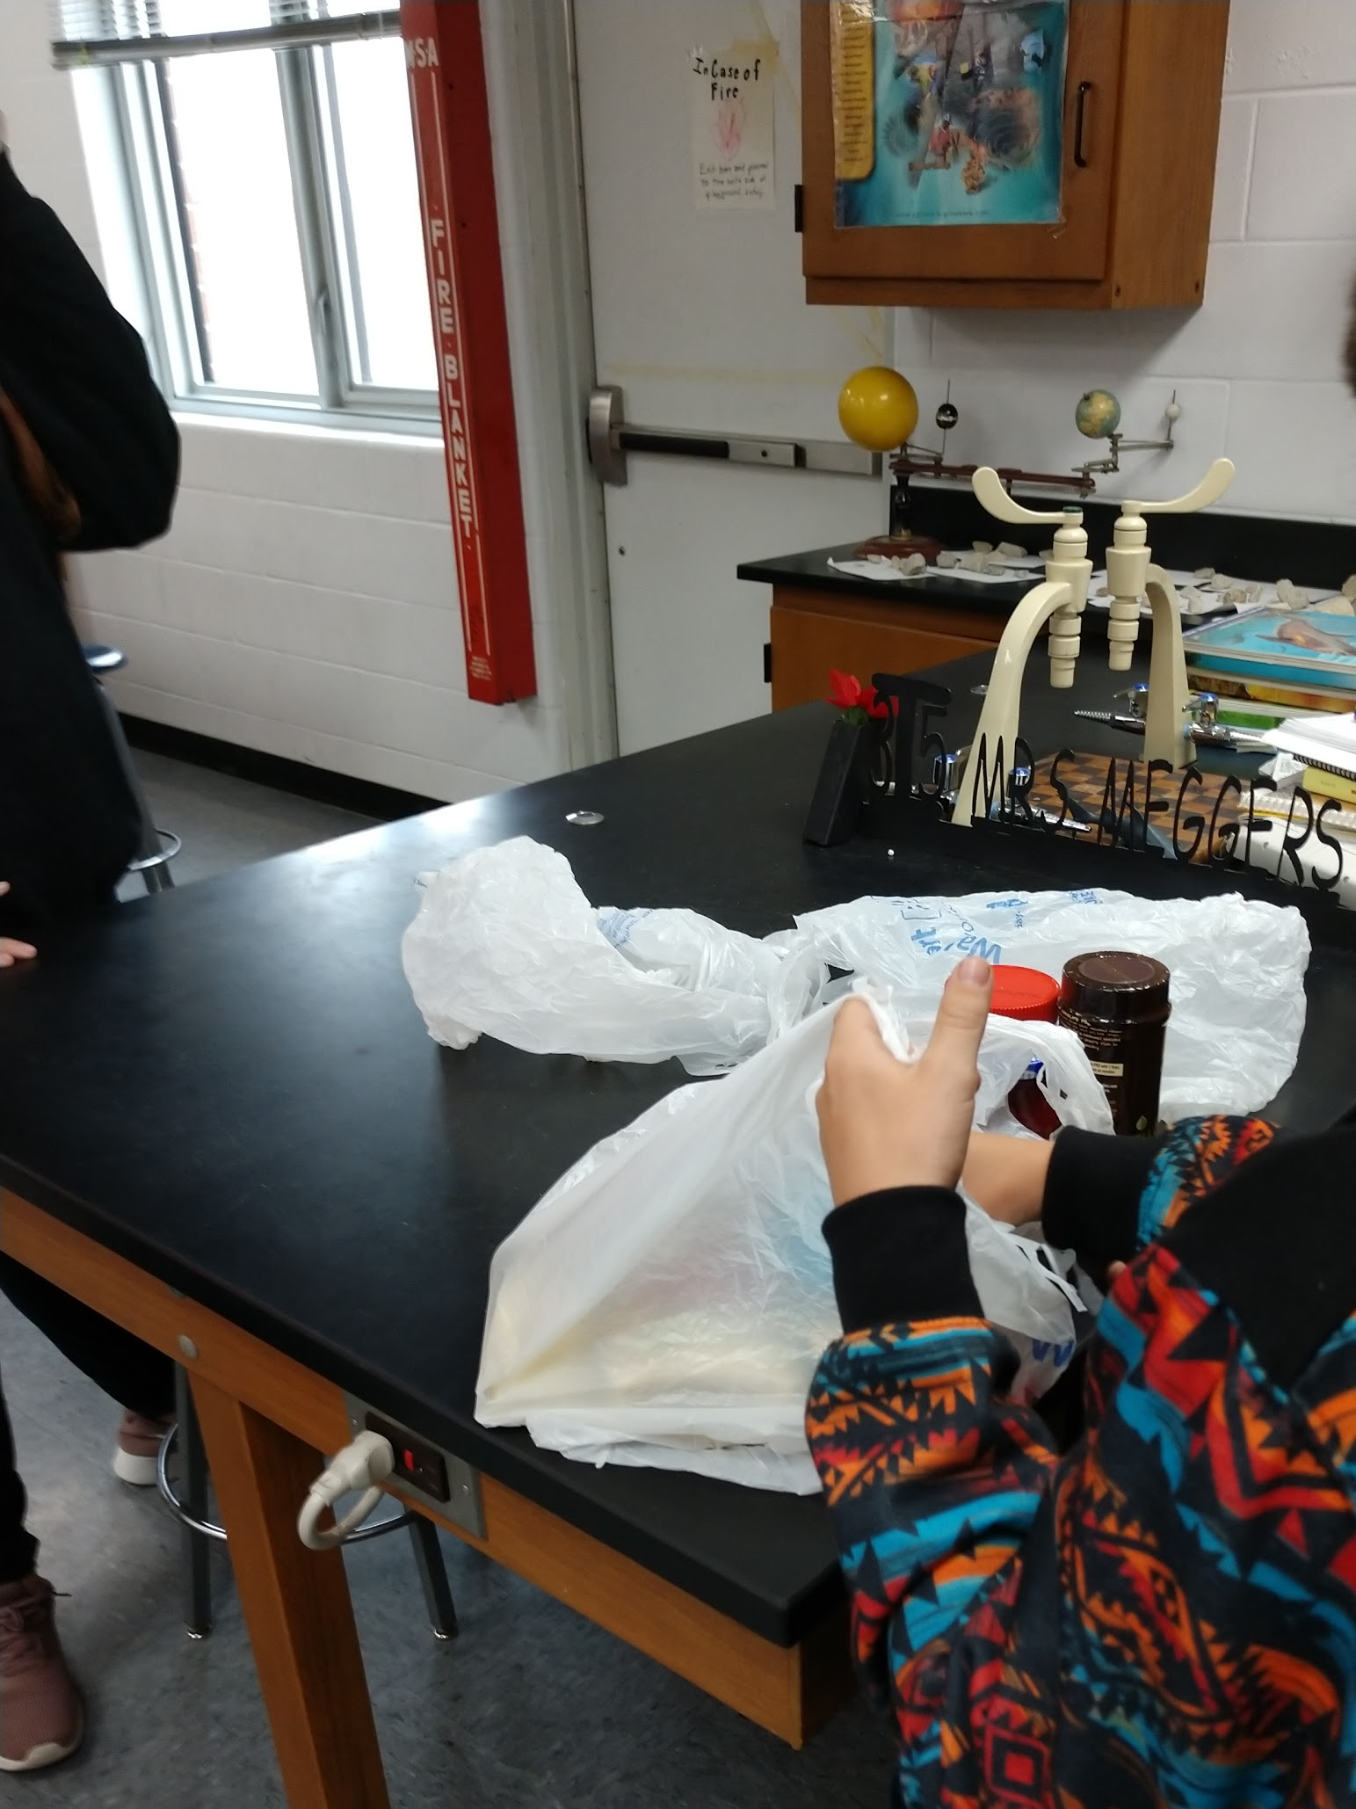
Students help unload and sort boxes .
26 local families are notified as soon as food becomes available via text and email. Backpacks stores and packing managed by students in middle school
Notes:
Sue

Slide 14
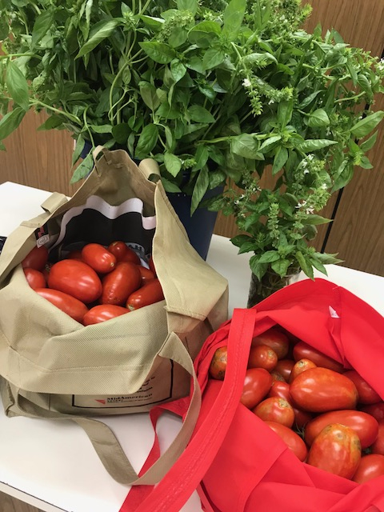
Produce Donations
Supplied by school kitchen garden with plans for expansion.
Green Wall
Greenhouse
Notes:
Sue

Slide 15
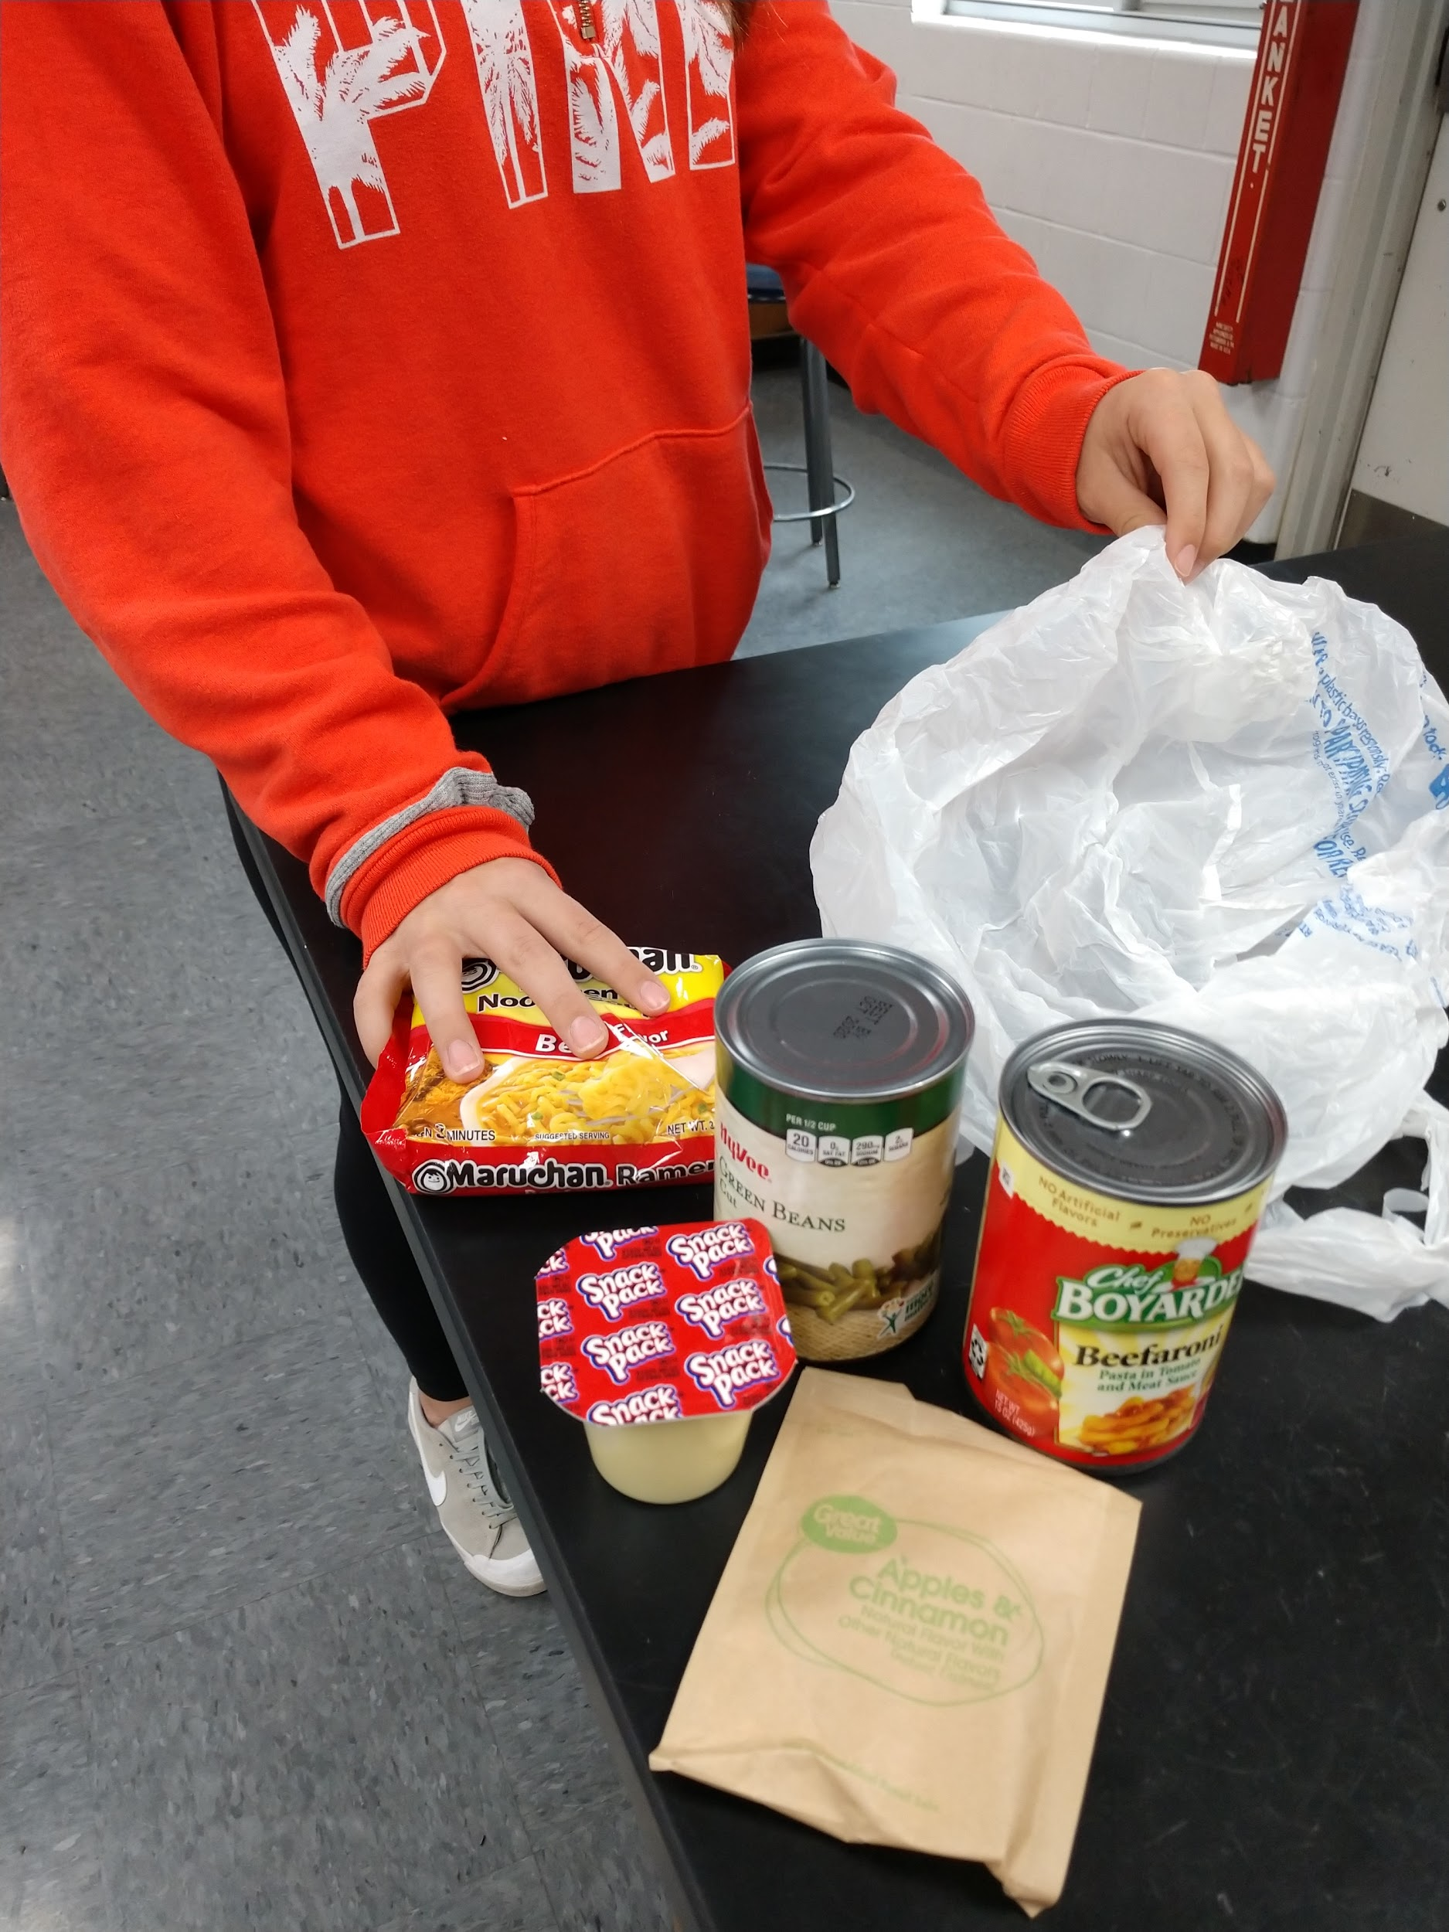
Backpack Program
Bags of non-perishable snacks and meal options are sent home twice each week
Family meal bags are packed by our middle school students and distributed by the elementary school counselor
Backpack Buddies - student friendly meals packed by high school students are distributed
Food bags are distributed discreetly in backpacks
Notes:
Jacob

Slide 16
Backpack Program
Number of families participating have increased each year
Link kids in the backpacks program to the food pantry program
Large food boxes are sent home before breaks (Thanksgiving, Christmas, Spring Break, Summer Break)
Food bags and boxes are supplemented by Power Snack vouchers
Functional Feeding
Two Opportunities Weekly
Notes:
Jacob

Slide 17
Testimonials
"When money is tight it helps a lot. It has meal options to make and healthy snack options. We have really enjoyed it. Thank you!"
"It helps us out, especially around the holidays. We really appreciate the help".
"This is a great program that helps our family tremendously, and we are glad it continues each year”'.
"I have noticed that my child likes the food that is being sent home".
“It is a relief knowing that we have supplemental food options for our family every week”.
Quotes from families who benefit from our Backpacks program

Slide 18
Next Steps
“Breakfast Bar” for High School
Seeking those in need
We serve around 66 students, yet 24% of our population is identified as Free and Reduced status.
Are there more students to serve?
How do we communicate availability?
How do we help families develop trust in our program?
How can other schools replicate this program?
Stopping Hunger
Increasing Learning
Notes:
Sue & Jacob

Slide 19
Contact Information
jheddinger@i-35.k12.ia.us
smeggers@i-35.k12.ia.us

